Slide 1
Chapter 3: Locating Facilities Using a Distance-Based Approach

Slide 2
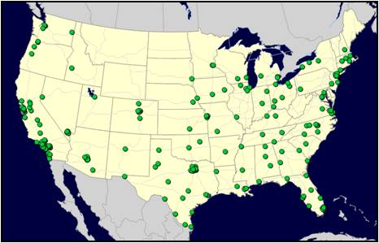
Al’s Athletics – Corporate Background
In the late 1960’s, Al Alford decided to open a business catering to the young potential sports stars in his small town of Brownfield, TX. The first sporting goods store was such a success that the Alford family soon added many more stores in similar small towns across the south.
50 years later Al’s Athletics is one of the largest retail sporting-goods chains in the US and now has major retail-store outlets in 41 states.
Store/Customer Map for Al’s Athletics
Competition in the sporting goods market is currently very high and Al’s grandson, who is now in charge of the company, realizes that they must find ways to offer better service and lower their transportation costs in the face of ever increasing fuel prices.
Based on the initial benefits the company realized by adding a single warehouse in Lubbock, TX, Al the Third decided that Al’s Athletics needed to add more warehouses to service the rest of the markets across the entire US.
The question was… how do they determine the ‘best’ number and location for these additional warehouses?

Slide 3
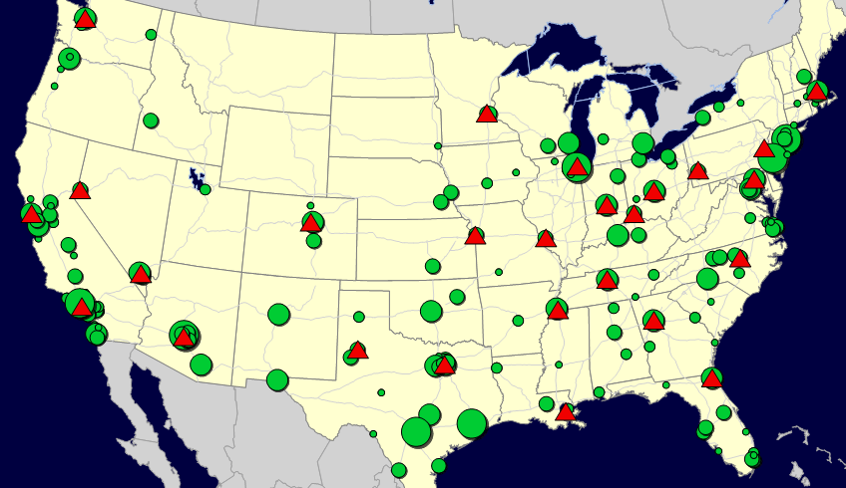
Al’s Athletics – Problem Definition
Al’s team decided to use a commercial Network Design application to find help them find the optimal answer to their question.
The team generated a list of 24 potential locations where they could easily enter contracts with a 3PL to lease space within their existing facilities. You can see these locations plotted on the network picture below.
Their study needed to consider not only the geographic location of all the stores but also consider their relative importance based on their ‘demand’ or amount of product required by the customers shopping there. (Think of the similarity of this to weighting potential Logistica capital city locations by population in our previous modeling)
22 Potential Warehouse Locations plotted against Customer Locations sized by Relative Demand

Slide 4
Definition of “Customers”
When modeling a supply chain, we will use the term “customers” to refer to the end point of the supply chain
That is, the point we need to deliver to
The “customer” need not be an end consumer or even a single entity.
For example, in Al’s, the “customers” are the collection of stores in a given city
In general, what do you think we could model a “customer” as?
Stores
ZIP or Postal codes you deliver to
A pool point where goods are consolidated for final shipment to the store
Another company’s warehouse or manufacturing site
Your own final set of warehouses (if the customer assignments don’t change)
A port of exit
And, so on…

Slide 5
Definition of “Demand”
Once we have customers, we need to assign each customer a “demand”
What are different ways you could think of modeling demand?
In this case, we define the “demand” as the total amount of product we need to get to each customer in the time horizon of the model
Time horizon is usually annual
Total amount of product is measured in a way that makes sense for logistics
Total weight
Total cases
Total pallets
And, so on…
(But, not total revenue)
We will talk about products later, but this can refer to groups of products, not necessarily (and almost never) individual items

Slide 6
Let’s do Al’s Case in PuLP

Slide 7
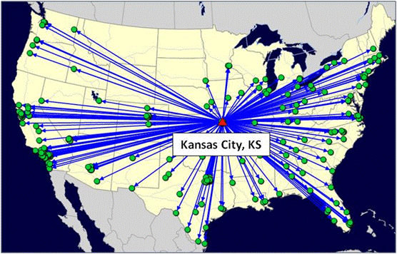
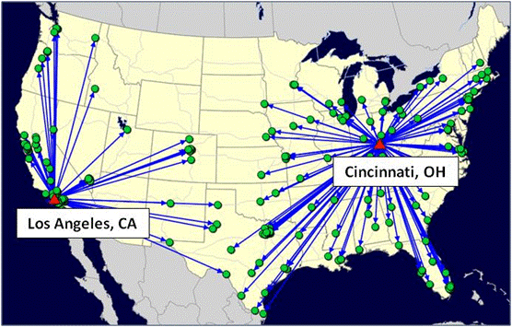
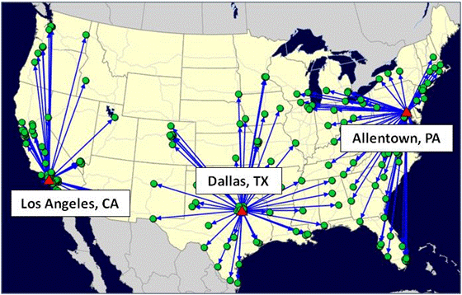
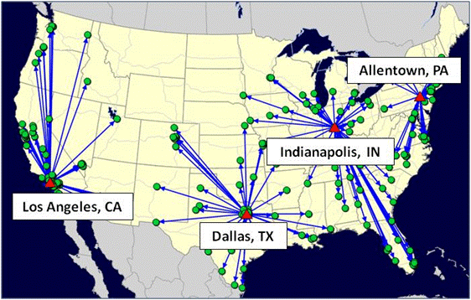
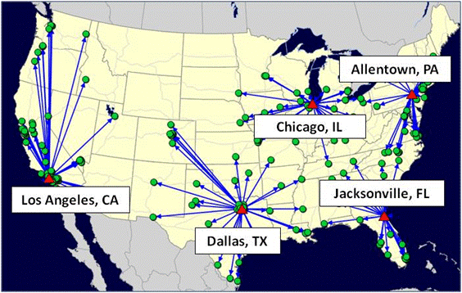
Al’s Athletics – Scenario Results Best 1-5
Best 1 Warehouse
Best 2 Warehouses
Best 3 Warehouses
Best 4 Warehouses
Best 5 Warehouses

Slide 8
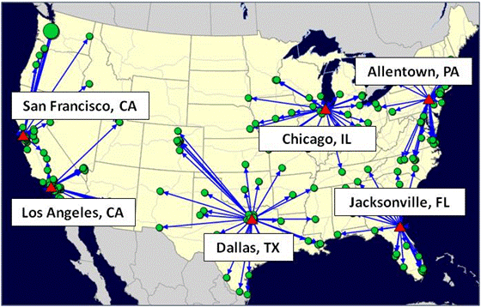
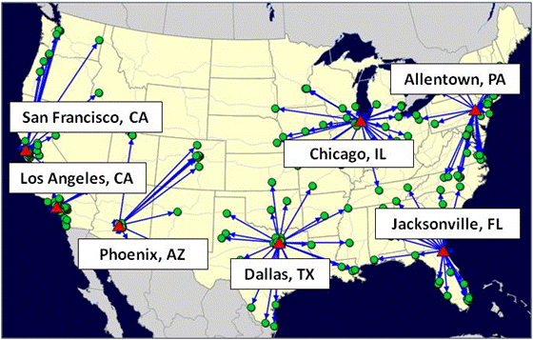
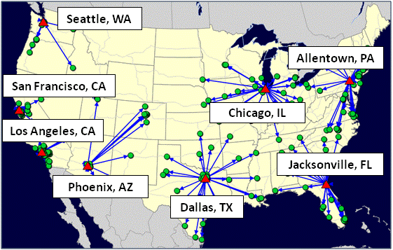
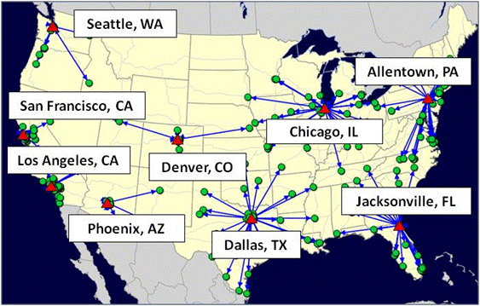
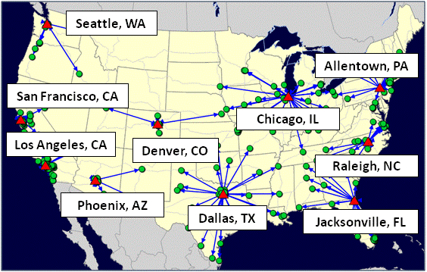
Al’s Athletics – Scenario Results Best 6-10
Best 6 Warehouses
Best 7 Warehouses
Best 8 Warehouses
Best 9 Warehouses
Best 10 Warehouses

Slide 9
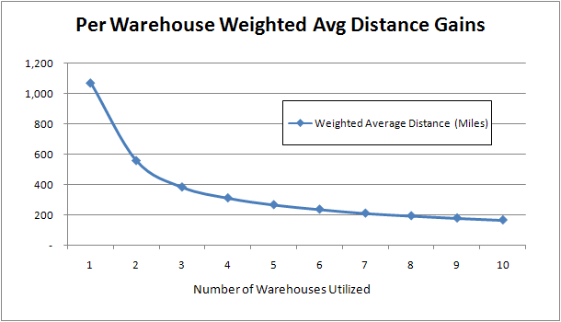
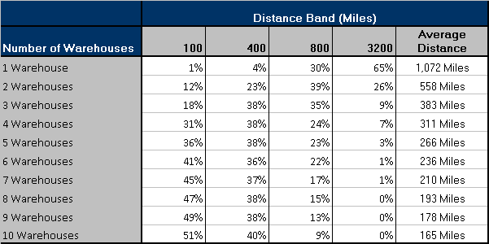
Al’s Athletics – Scenario Comparisons

Slide 10
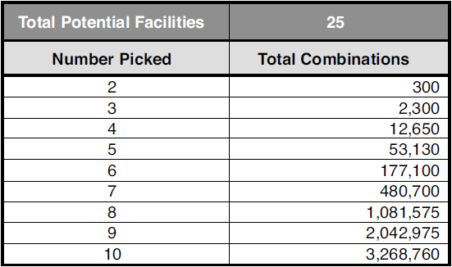
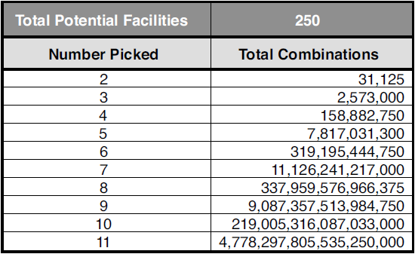
Size of Problems
In the Logistica case, where we picked just a single site, you can quickly generate all possible answers
If you are picking multiple sites, the problem size grows very quickly:
You need to use mathematical programming techniques to sort through these combinations

Slide 11
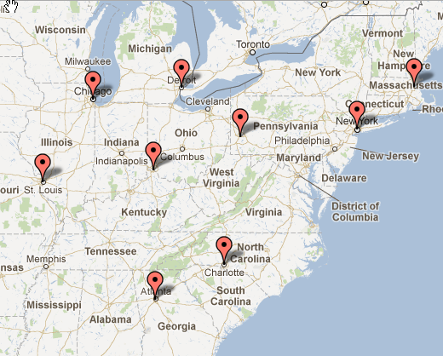
Don’t Be Intimidated by the Math Formulation
Going through the math formulation helps you systematically understand how to approach these problems
Just knowing about the math formulation allows you to think logically about the problem
We use the math formulation to help you build intuition
We will take you through the math formulation, step-by-step, with the MIP 9-City example
MIP 9-City Example
Use the spreadsheet from the book Web site
This simple example has 9 U.S cities, see map to the right
This problem is like Al’s, except much smaller
Map source: geobatch.com

Slide 12
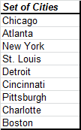
Terminology- Customers
We have a set of customers we want to serve. We call this set “J” (the capital letter J). If we use lowercase j, we are referring to an individual customer
In the MIP 9-City Example, the set J is the full list of customers (this list can be found in cells A14:A23)
A single customer in this list is referred to as j (lower case j).
We do this so we can formulate a general problem that will work for any number of customers.
Once a solver engine starts to work, it will internally number these items. So Chicago will be j =1, Atlanta j = 2, and so on. But, we don’t need to worry about that when we formulate the problem.
All these customers are referred to as J (capital letter J)

Slide 13
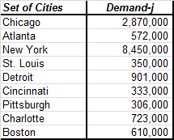
Terminology- Demand
In our formulation, demand occurs at a customer. We refer to demand d (lower case d) and append a subscript to indicate which customer. So, demand at a customer is d_{j}.
Now, you can see why we used the lower case j for the customers– this gives us a way to indicate, with just two letters (d_{j}), that we have demand at each individual customer
In the MIP 9-City, this is seen in cells B14:B23 (there is a typo in the book where we put an i instead of a j)
We only needed the demand column, but we are showing the customers as well so you can see the demand by customer

Slide 14
Terminology- Facilities
We have a set of facilities we want to pick from serve customers (these can be warehouses, plants, etc). We call this set “I” (the capital letter I). If we use lowercase i, we are referring to an individual facility
In the MIP 9-City Example, the set I is the same list as the customers (this list can be found in cells A14:A23)
The list doesn’t have to be the same. It is different in Al’s.
When the solver engine runs, it treats the list of cities as two tables
A single facility in this list is referred to as i (lower case i).
We do this so we can formulate a general problem that will work for any number of facilities.
Once a solver engine starts to work, it will internally number these items. So Chicago will be i =1, Atlanta i = 2, and so on. But, we don’t need to worry about that when we formulate the problem.
All these cities are both customers and potential facilities. They are referred to as I (capital letter I)

Slide 15
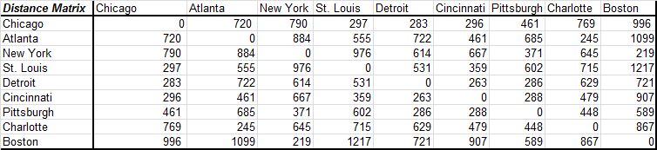
Terminology- Distance Matrix
In this formulation, we are concerned about the distance between facilities and customers. We need a distance matrix that shows us every combination. We call this dist_{i,j}
The term dist refers to the fact that this term represents the distance. The i,j subscript tells us that it is the distance between facility i and customer j.
Again, we see the value of the set names. With the word dist and two letters (i and j), we can compactly represent a distance matrix that can be as small as 1 record or as large as millions (or more).
Note that is an input to the model
We have provided the distance matrix cells A40:J49
In practice (like in Al’s), this can be generated automatically (but, it needs to be generated)

Slide 16
The Objective of the Optimization
We want to minimize the average weighted distance from the facilities to the customers
This is equivalent to minimizing the total weighted distance, but the average is easier to understand
We are using demand to as our “weights”

Slide 17
The Constraints of the Optimization (1)
We have to meet all demand
If we don’t have this, we could reduce distance by not meeting demand
We can only locate a certain number of facilities. We will call this number P.
This allows to us to determine the best 1, 2, 3, and so on facilities
Why do we need to limit the number of facilities (P), why don’t we let the optimization give us the best number?
In this model, without a limit, the model may just select every facility

Slide 18
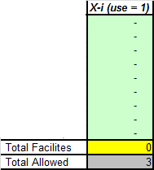
The Decisions of the Optimization (1)
Do we pick a particular facility or not?
We will designate this decision as X_{i}.
Remember the i indicates one of the potential facilities
We will allow X_{i} to take on two values, 1 or 0. If it is 1, it means that this facility is used in the solution. 0 it is not.
This is a binary variable because it is either 1 or 0. In this case, it does not make logical sense to open ½ of a warehouse
The X_{i} variables can be seen in cells C14:C23. Note that we add this column and compare it to the total allowed, P.
When we run the optimization, we will be trying different combinations of facilities (by putting a “1” in different places) and seeing what the average distance is. Mathematical optimization has systematic ways to do this.

Slide 19
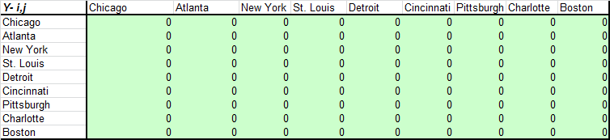
The Decisions of the Optimization (2)
Which customer is assigned to which facility?
We will designate this decision as Y_{i,j}.
Remember the i indicates one of the potential facilities and j one of the customers
In this case, to start, Y_{i,j} can only be 1 or 0. If it is 1, it means that customer i has all its demand met from facility j.
The Y_{i,j} variables can be seen in cells A27:J36.

Slide 20
The Constraints of the Optimization (2)
Now, that we have defined the decisions, another logical constraint becomes obvious:
If a customer is served from a facility, then that facility must be opened
This constraint will tie the X and Y decisions together. This constraint forces the solver to pick the best values of X and Y at the same time
We will cover how to mathematically write this constraint in a few slides– this constraint will be an example of writing an IF-Statement using algebra

Slide 21

Formulating the Math Problem: The Objective Function (1 of 3)
Our objective is to minimize the total weighted distance from facilities to warehouses. Mathematically, we express this as:
If two variables are next to each other, we are using the standard algebra notation meaning we multiple them together.
So, in this case, we multiple distance times demand times Y: dist_{i,j} d_{j} Y_{i,j}
The summation sign (Σ) means sum the terms,
The “∈” means element. So, under a summation sign, we need to know what we are summing over. “i ∈I” means we sum up each of the individual facilities and “j ∈ J” means we sum up over every individual customer in the customer list. (In Excel, we specify the cells we want to sum over. Here we can it in a more general way without having to know the specific cells).
Minimize

Slide 22
Formulating the Math Problem: The Objective Function (2 of 3)
Our objective is to minimize the total weighted distance from facilities to warehouses. Mathematically, we express this as:
So, for any possible values of Y_{i,j} we can determine the value of the objective function:
For every possible combination of i and j, we can simply multiple out the term: dist_{i,j} d_{j} Y_{i,j}
We then add up all these values (we need two summation signs because we have to add up every possible i value and every possible j value
Minimize

Slide 23
Formulating the Math Problem: The Objective Function (3 of 3)
Our objective is to minimize the total weighted distance from facilities to warehouses. Mathematically, we express this as:
Now that we know how to find the value of the objective function, we want to try different values for each of possible Y_{i,j} combinations to see which one gives us the lowest total number
We use mathematical programming for this (but could try a few by hand)
If we don’t define anything else but this equation, what will the solver do?
Set the Y variables to very large negative numbers..
If we make the Y variables 0 or 1, what will it do?
Set every Y to 0…
You can see that we’ll now need to guide the solution with constraints. Once we do this, how would you describe how the solver chooses to set a Y variable to 1 rather than 0?
Sparingly, grudgingly, miserly
If you give the solver an escape route, it will set it to 0
But, if you are overly cautious and make mistakes, it may be forced to set them all to 1!
Minimize

Slide 24
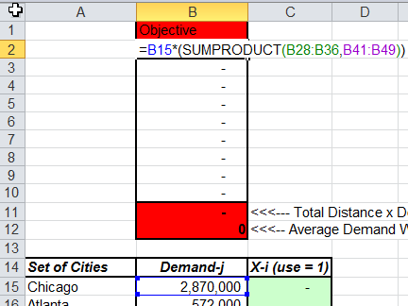
Formulating the Math Problem: The Objective Function (practice)
The mathematical notation allows us to write a compact objective function:
In Excel, there are many ways to do this. Go to cells B1:B11 to see one way
Minimize
In cells B2:B10, we are multiplying the demand (B15) by the distance (B41:B49) by the Y_{i,j} variable (B28:B36). We are also taking care of the summation over all customers (J) with the SUMPRODUCT function. In effect, we have locked in a value for i (by just taking one column of the Y_{i,j} table.
To include the second summation, we just sum columns B2 to B10.

Slide 25

Constraint: Every Customer Must Be Served
To ensure every customer must be served, we need a constraint for every customer . We can compactly write this as:
The symbol, ∀, means “for every.” So, in this case, we have a constraint for every individual customer in the full set of J customers.
So, for each of these constraints, we sum all the Y_{i,j} values over all possible values of i (but remember, j is fixed for any one constraint). This value must add up to 1 (think of 1 as 100% of the customer demand)
How do we ensure we are meeting all the demand? (For example, demand may be 1556, or 4.5 million, etc?
This is covered in the objective function where we multiple out the demand with the Y variabile

Slide 26
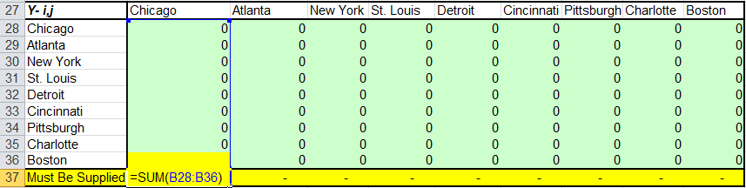
Constraint: Every Customer Must Be Served (In Excel)
To ensure every customer must be served, we need a constraint for every customer . We can compactly write this as:
In Excel, each column represents the “∀ j ∈ J” part– one constraint per customer
The summation in row 37 the sum over all the Y_{i,j} for a given j value.
Each cell in row 37 must equal 1. So, in this case, there are 9 constraints

Slide 27

Constraint: Pick Just P Facilities
To ensure we pick just P facilities, we need the following constraint
We just sum up over all possible facilities and this number needs to equal P
In Excel, this is relatively simple (in C14:C25)
We sum up all the X values
And, it must equal P

Slide 28

Constraint: If a Customer is Served from a Facility, That Facility Must Be Opened
We need to ensure that if a customer is served by a facility, then that facility is open. (These constraints link X and Y together). This is a family of constraints. You need a unique constraint for every combination of i and j. They are written as follows:
Here is a thought exercise to understand this constraint
We have a constraint that says a customer must be served 100%.
In our objective function, for a given customer (a given j), we want to set a Y_{i,j} equal to 1 where the distance is low, and set all the other Y_{i,j} ‘s for that customer to 0 so we can keep the objective function low.
We could pick the best Y_{i,j} for each customer in that way.
If we do this, we will likely find that the Y_{i,j} ‘s we set to 1 will have all kinds of different values for i. That is, some will correspond to Chicago, some to St Louis, some to New York and so on.
This would lead to opening more than P sites.
We don’t (yet) have a way to prevent this.
This constraint says that if we want to set a Y_{i,j} to 1, then we need to look at the X_{i} value (for the same i) and make sure that is at least a 1.
Since we have a constraint that limits the number of X variables we can pick, this family of constraints forces us to choose wisely.
This is a lot like an IF-Statement

Slide 29

Constraint: X and Y must be 0 or 1
We have two more simple constraint sets that tell the solver to set X and Y to 0 or 1
Later, we can relax the Y restrictions, but for now this tells us the valid values for X and Y

Slide 30
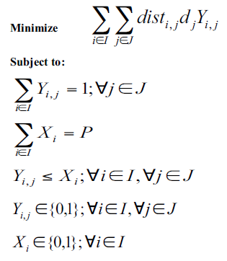
The Full Math Program

Slide 31
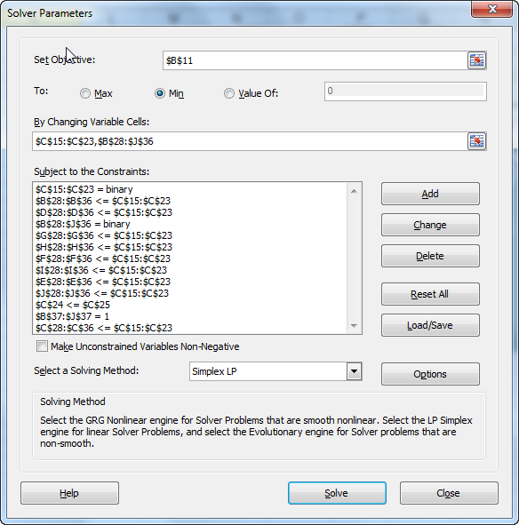
The Same Problem in Excel: (There may be other ways to formulate this, but Excel’s Solver Definition is not as generic)
*
* All the unmarked constraints in Excel belong to this family of constraints

Slide 32
Lessons Learned
Even with just distance, the problem is realistic
In some supply chains, being as close to the customers is the primary goal
Distance is a good measure of speed of delivery and an approximation for transportation costs
Even just considering distance, when you locate more than one facility, the problems become more complex
The mathematical formulation gives us a logical way to think about the problem and a method for feeding the problem to a commercial solver or Excel
Running multiple scenarios is a good way to understand the impact of changes in the supply chain and the marginal value of additional sites

